Slide 1
Impact of Covid-19 Pandemic on the Global Economy:
Emphasis on Poverty Alleviation and Economic Growth

Slide 2
ABSTRACT
The COVID-19 pandemic rendered many of the world's population impoverished, plunging them into recession which has devastated the global economy. The pandemic generated so many uncertainties regarding economic and social policies. This present study seeks to shed more light on the pandemic's impact on poverty alleviation and the global GDP by considering individual countries' heterogeneous effects in a panel study. 170 countries are utilized in this study, and data collected from Kaggle.com, comprising total COVID-19 cases, total deaths, stringency index, human development index, and gross domestic product per capita. The study is mostly to visualize the correlation of features and findings stipulate that many people's stringency and the contraction of the disease have inversely affected poverty alleviation and economic growth. Ironically, the deaths recorded positively affects both poverty alleviation and economic growth. This shows the essence of controlling population growth as it impedes economic growth and poverty alleviation. This study recommends that governments should invest in health and education improvement create employment that could propagate growth to improve poverty alleviation and economic growth

Slide 3

Introduction
The effect of the pandemic on global economies and social policies can never be emphasized. Unemployment rocked countries across the globe due to stringent measures put in place to curb the spread of the virus. This singular action impacted economies and their standing, ironically for good.
Generally, some believe it has negatively impacted the economy, while others have used it as an opportunity to stimulate economic growth. These classifications may have created a dynamic that is difficult to determine. Leaving most susceptible to misinformation

Slide 4
Introduction
Our study aims to discover,
Whether or not the Covid-19 pandemic has had a negative or positive impact across the globe. And possibly specific countries.
What are the correlations between deaths or cases and the global economy?
How did the pandemic reduce or increase poverty through population control?
What is the correlation between stringency index and the global economy
National and international leaders need to acquire this account because it aims to provide them with an understanding of the dynamics the pandemic has employed on the Global Economy. We look towards identifying trends and behaviors under uncertainty to give us an account of how we should proceed with poverty alleviation and economic growth. After doing so, it is the objective of this study to make sense of the data and purposely create a model that will provide a framework to make decisions about the Global Economy.

Slide 5
methodology
DATA: This data was gotten from Kaggle.com which had features such as:
Code - This column represents the ISO Codes given to a country. Each Country gets an ISO Code that can be of two forms - Alpha_2 and Alpha_3. We can use these codes to find the continent the country resides in.
Country - This column contains the names of countries whose data has been mentioned.
Year - We are considering cases only till October 2020, so the cases begin from December 2019.
Month - Contains months from December 2019 to October 2020.
Population - Shows the population of each country around the world. Crucial for our analysis.
GDP_Cap - Represents the GDP per Capita offered by a country. GDP is the Gross Domestic Product. It refers to the sum of money that a particular state can use for the welfare of its citizens. GDP per Capita is the division of the GDP among the citizens. Higher the GDP per Capita, more the country is capable of handling pandemic level situations like COVID-19.

Slide 6
methodology
HDI - Stands for Human Development Index. It is a measure of average achievement in key areas of human development. These could include healthcare facilities, medical advancements etc. Simply put, higher the HDI, better chances of citizens surviving a COVID-19 pandemic.
TC - Refers to Total Cases. Measured daily, this tally gives us the number of people affected by the COVID-19 pandemic.
TD - Refers to Total Deaths. Measured daily, this tally gives us the number of people who died as a result of contracting the SARS-COV-2 virus.
Stringency_Index - Refers to how strict governments around the world became during the pandemic. Also refers to how stringent people became about following lockdown rules. In simpler words, it refers to how willing people were to following the rules of a pandemic.

Slide 7
methodology
Dependent variables included the human development index (HDI) and the gross domestic product per capita (GDP) and the independent variables being the stringency index, total confirmed cases and total confirmed deaths.

Slide 8
Data Preparation
raw_data – unnamed columns, missing values, “#NUM”
transformed_data – missing values (HDI)
raw_data vs transformed_data – scale and visual
Datatypes – float, int, string (object)
convert date to datetime object

Slide 9
Data Preparation
Noise when evaluating the distribution of the data because time is disregarded
Low positive correlation between covid-19 features and economic features via visualization and statistical tests
GDPCAP, POP and HDI were constant throughout 2020
Continent data

Slide 10
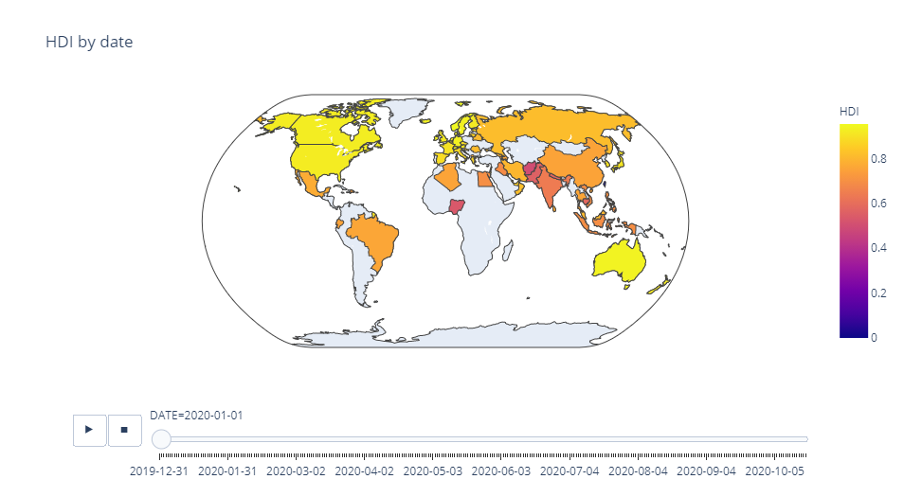
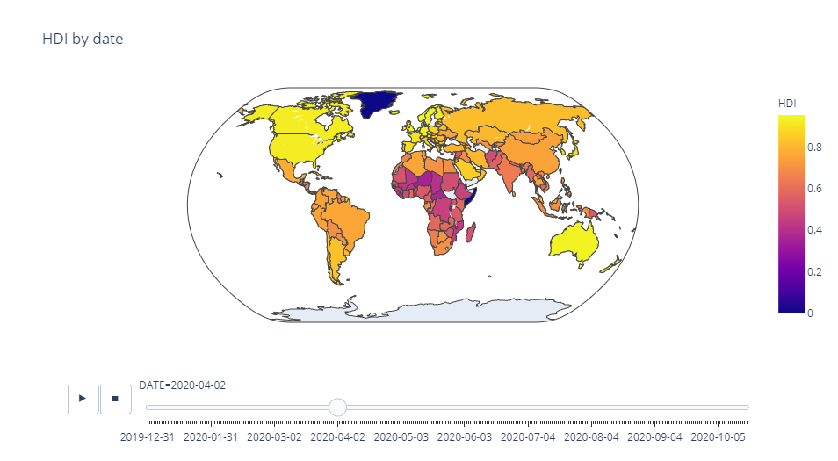



Slide 11
Results
Impact on poverty alleviation: The total deaths resulting from the pandemic positively impacted poverty alleviation efforts and the human development index.

Slide 12
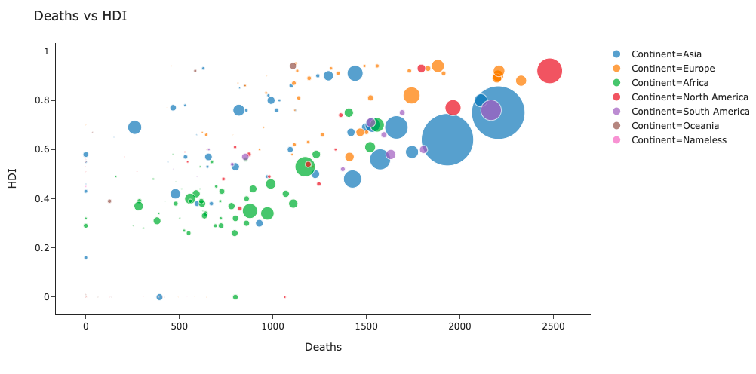
Deaths vs hdi

Slide 13
results
Impact on economic growth: Increasing stringency positively supports increasing economic growth where there is an increase in death while at the same time reducing the total confirmed cases.

Slide 14
Conclusion
This study aimed at assessing the effects of the pandemic on global economy, emphasizing on economic growth and poverty alleviation efforts. The data contained 170 countries which had features stringency index, total cases, and total deaths, gross domestic product per capita, human development index.
The study found that the pandemic had a significant impact on economic growth and poverty alleviation. To be specific, it was observed that the stringency measures put in place and the number of cases recorded have an adverse impact on poverty alleviation efforts.

Slide 15
Discussion
Further development
Obtain up-to-date measures and reliable data for each country
Build a model to predict GDPCAP or HDI over time – time series analysis

Slide 16


Questions

